Slide 1

Marketing Research and Analysis

Slide 2

Aim of Our project
Introduction
The hairdressing industry is rapidly evolving, with a growing demand for efficient appointment booking systems.
Expert Care aims to address the challenges faced by both hairdressers and clients in managing appointments effectively.

Slide 3

Market Research
Target Audience
Description: Hairdressers seeking to expand their client base and individuals looking for personalized hairdressing services.
Market Size and Growth
Hairdresser Market Demographics
Population: Approximately 120,000 hairdressers across Canada
Median Age: 37 years
Number of Salons: 812116 Unisex hair salons nationwide increase of 2.86% from 2023.
The Canadian hair market is worth over $4 billion.
Median Household Income: $55,000 CAD

Slide 4

Trends:
Social Trends:
Increasing emphasis on personalized experiences in hairdressing services.
Growing demand for diversity and inclusion in the hairdressing industry.
Political Trends:
Focus on regulatory compliance in health and safety standards.
Government initiatives to support small businesses in the beauty industry.
Technological Trends:
Advancements in online booking software and virtual consultation platforms.
Integration of AI and automation technologies in hairdressing tools and products.
Economic Trends:
Economic recovery post-pandemic leading to increased consumer spending on personal grooming services.
Adoption of value-for-money models to cater to price-conscious consumers.

Slide 5
Swot
Strengths:
Enhanced Client Retention: Reminder feature reduces no-shows, boosting client loyalty.
Time-Saving Operations: Online booking streamlines scheduling, freeing up time for client service
Weaknesses:
Technical Reliance: Dependency on technology may disrupt salon operations.
Hairdressers may lack proficiency in using digital tools and may find it challenging to adapt to new technologies, leading to underutilization of the application's features.
Opportunities
Specialized Features: Develop features specifically designed for hairdressers' needs, such as client hair history tracking, appointment notes, or customizable service menus.
Threats:
Competition from Similar Platforms: Other software providers offering similar solutions for hairdressers may pose a threat, especially if they have established a stronger market presence or offer more advanced features.
Resistance to Adoption: Some hairdressers may be hesitant to adopt new technologies or change their existing workflows, potentially slowing down the adoption rate of your platform.

Slide 6
Competitors
1. Jane App
Overview: Jane App offers salon management tools including appointment scheduling, client management, and marketing features.
Strengths: Robust feature set, user-friendly interface, and reliable customer support.
Weaknesses: Pricing may be prohibitive for smaller salons and independent stylists.
2. Traditional Salons
Overview: Traditional salons typically rely on manual processes for appointment scheduling, client management, and marketing.
Strengths: Established clientele, personalized service, and physical presence in the community.
Weaknesses: Limited by manual processes, lack of advanced management tools, and marketing capabilities.

Slide 7
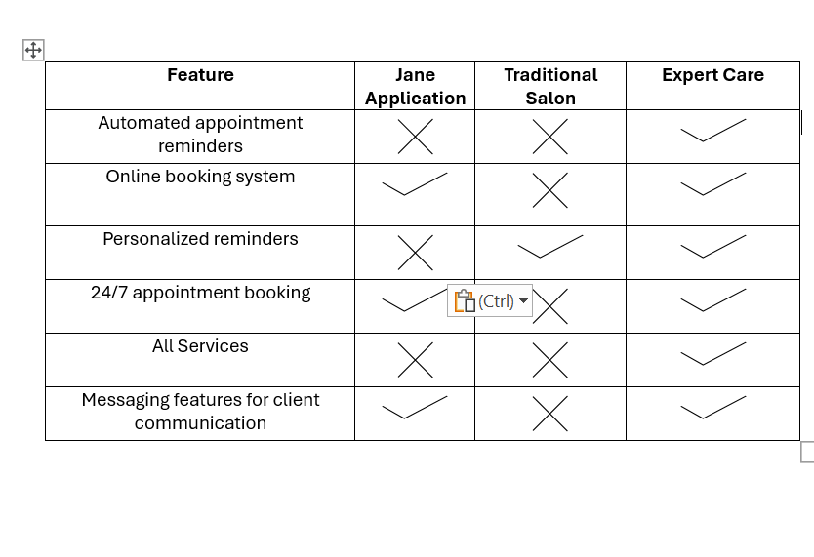
comparison table

Slide 8
Thank You

